Slide 1


Methods
Chris Piech
CS106A, Stanford University
This is Method Man. He is part of the Wu Tang Clan. ☺

Slide 2
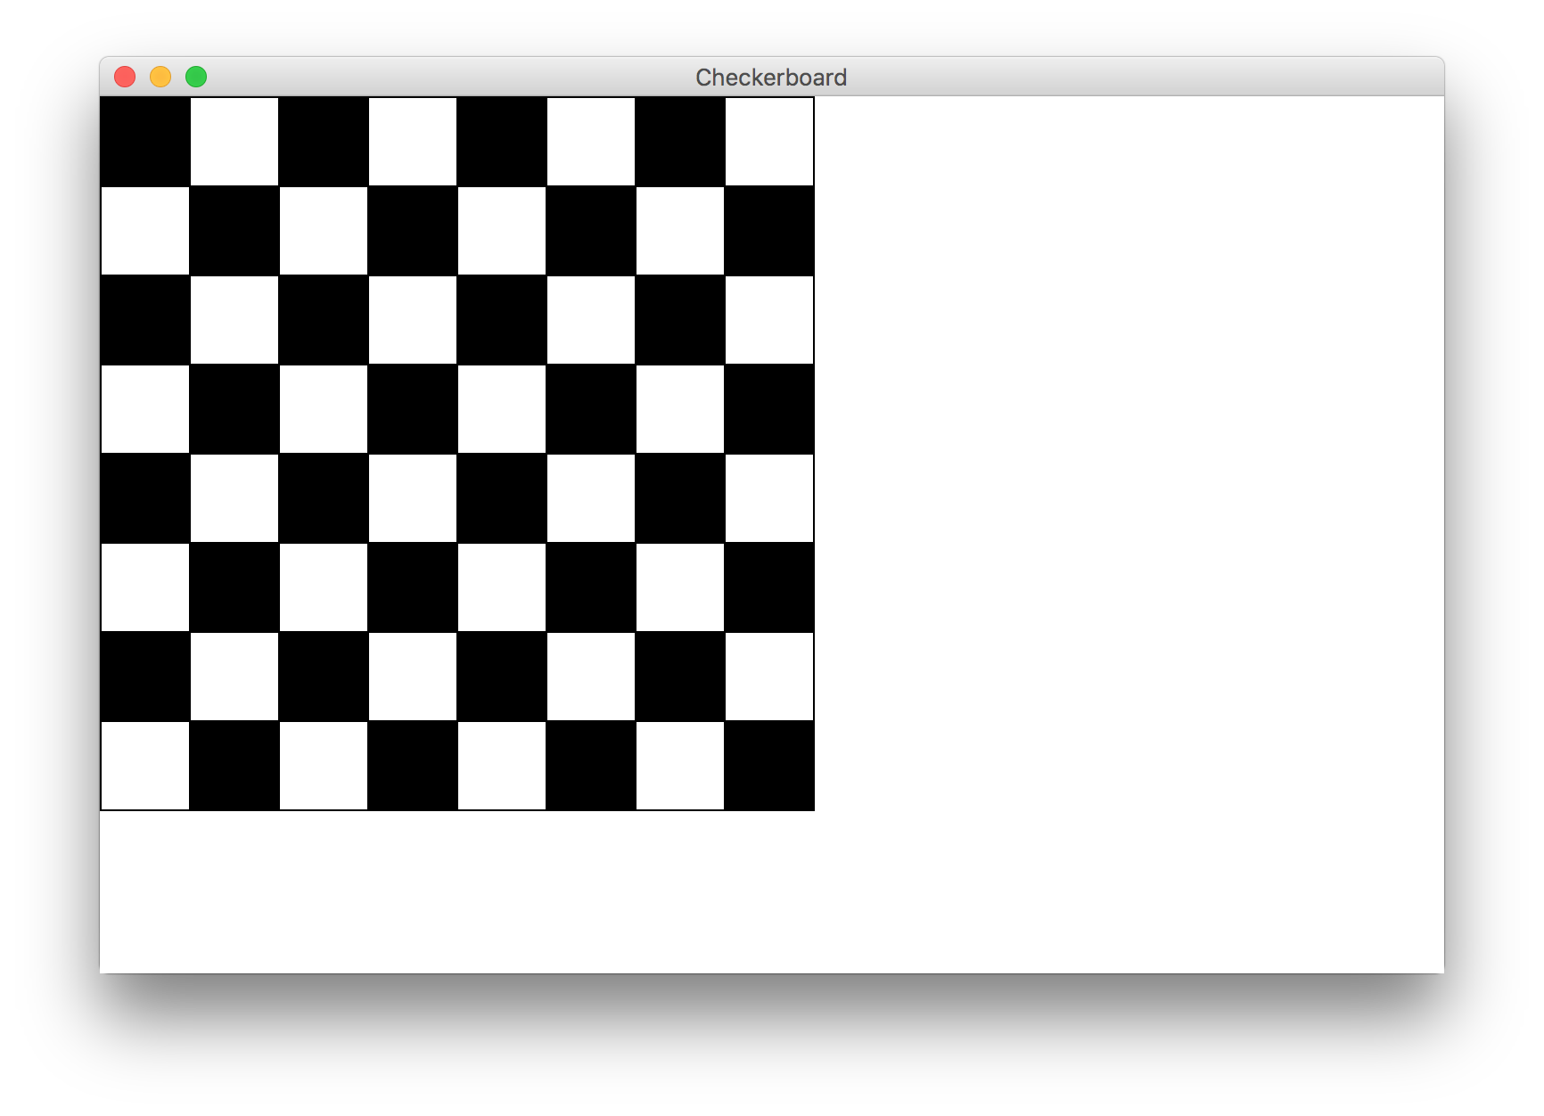
Goal

Slide 3
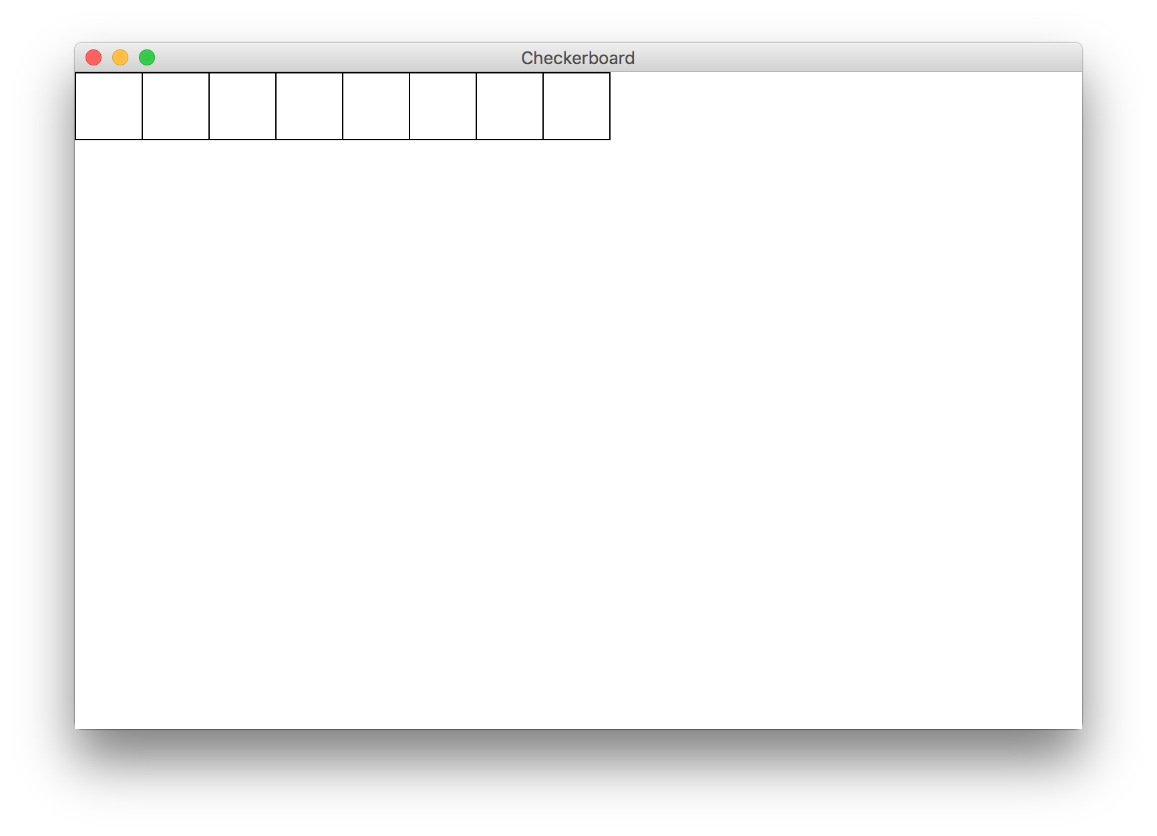
Milestone 1

Slide 4
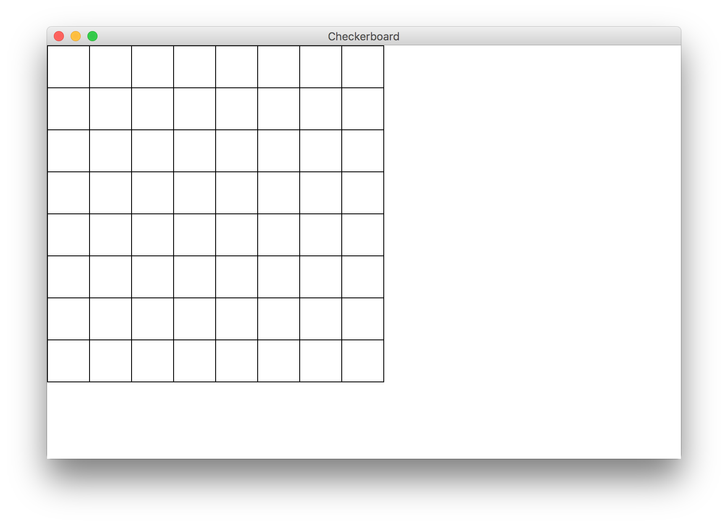
Milestone 2

Slide 5
Milestone 3

Slide 6
Civilization advances by extending the number of operations we can perform without thinking about them.
-Alfred North Whitehead

Slide 7

Learn How To:
Write a method that takes in input
Write a method that gives back output
Trace method calls using stacks

Slide 8
Calling Methods
turnRight();
move();
readInt(“Int please! ”);
println(“hello world”);
rect.setFilled(true);
drawRobotFace();
add(rect);
preventGlobalWarming();

Slide 9

Defining a Method
private void turnRight() {
turnLeft();
turnLeft();
turnLeft();
}
Big difference with Java methods:
Java methods can take in data, and can return data!

Slide 10
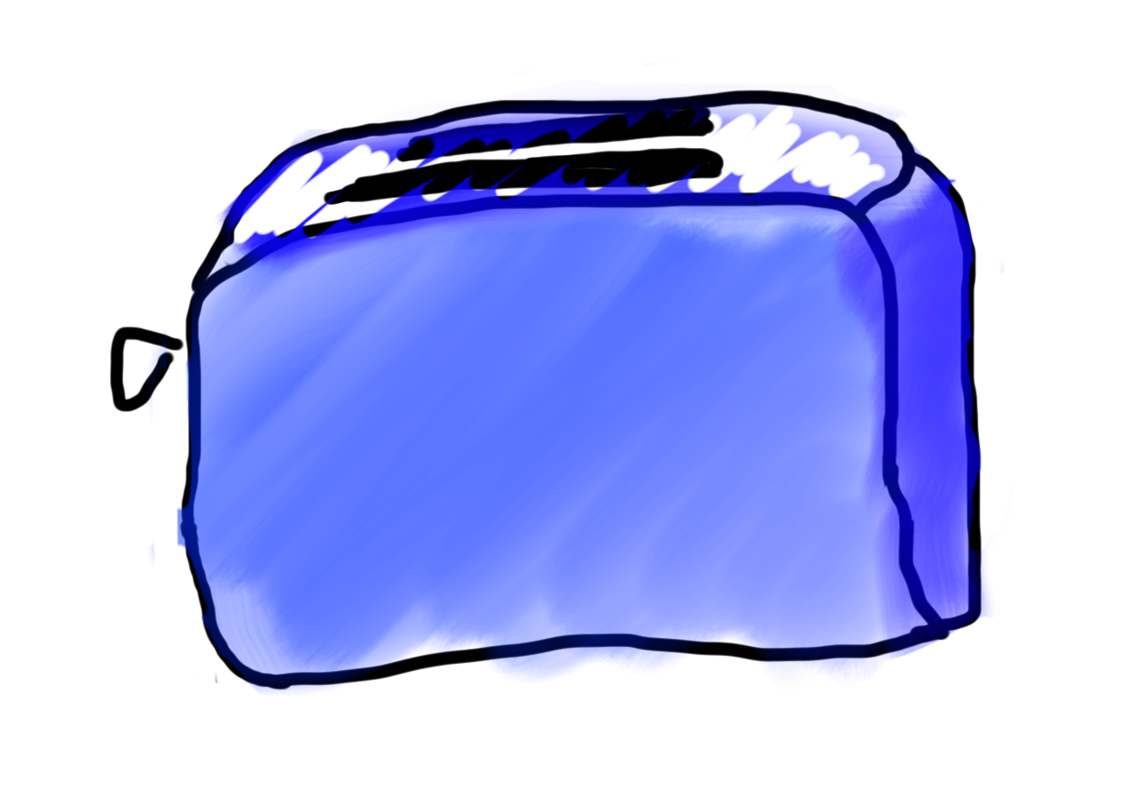
Toasters are Methods
For example:
runToaster
- Thanks Mehran

Slide 11

Toasters are Methods
parameter

Slide 12

Toasters are Methods
parameter

Slide 13
Toasters are Methods

Slide 14

Toasters are Methods

Slide 15

Toasters are Methods
return

Slide 16
Toasters are Methods

Slide 17

Toasters are Methods
* You don’t need a second toaster if you want to toast bagels. Use the same one.

Slide 18
Toasters are Methods

Slide 19

Toasters are Methods

Slide 20
Toasters are Methods

Slide 21
Toasters are Methods

Slide 22
Toasters are Methods

Slide 23
Methods are Like Toasters

Slide 24
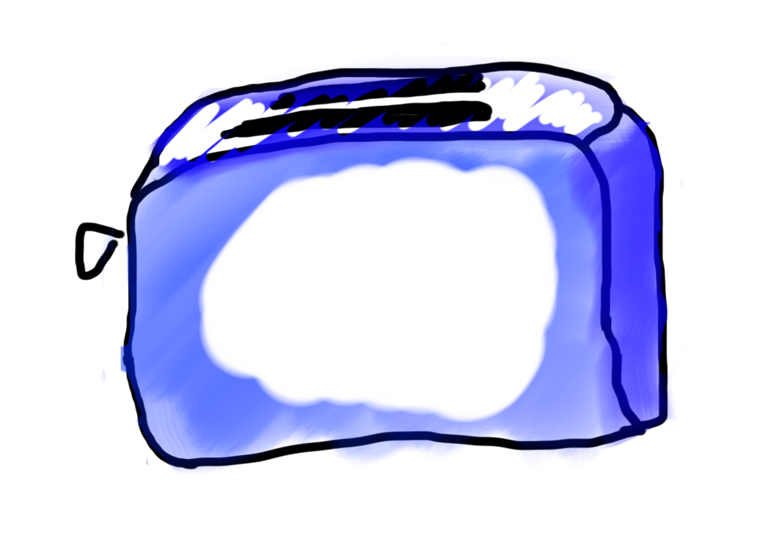
Methods are Like Toasters

Slide 25
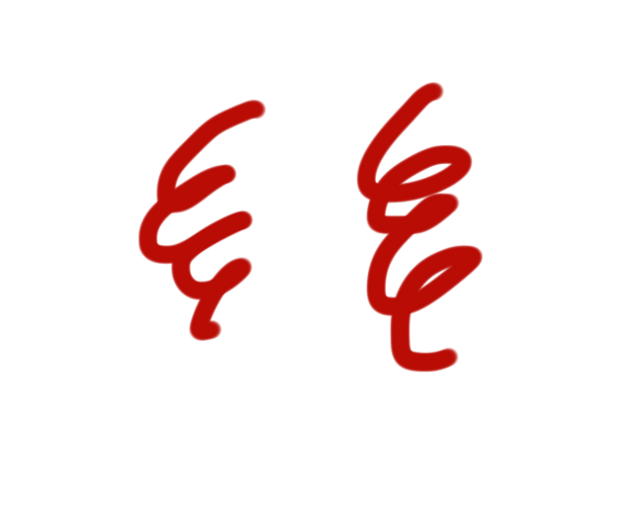
Methods are Like Toasters

Slide 26

Methods are Like Toasters

Slide 27
Methods are Like Toasters
parameter(s)
return

Slide 28
Formally
visibility type nameOfMethod(parameters) {
statements
}
visibility: usually private or public
type: type returned by method (e.g., int , double, etc.)
Can be void to indicate that nothing is returned
parameters: information passed into method

Slide 29
Anatomy of a method
public void run() {
double mid = average(5.0, 10.2);
println(mid);
}
private double average(double a, double b) {
double sum = a + b;
return sum / 2;
}

Slide 30
Anatomy of a method
public void run() {
double mid = average(5.0, 10.2);
println(mid);
}
private double average(double a, double b) {
double sum = a + b;
return sum / 2;
}
method “definition”

Slide 31
Anatomy of a method
public void run() {
double mid = average(5.0, 10.2);
println(mid);
}
private double average(double a, double b) {
double sum = a + b;
return sum / 2;
}
Output expected
Input expected

Slide 32
Anatomy of a method
public void run() {
double mid = average(5.0, 10.2);
println(mid);
}
private double average(double a, double b) {
double sum = a + b;
return sum / 2;
}
Return Type
Parameters

Slide 33
Anatomy of a method
public void run() {
double mid = average(5.0, 10.2);
println(mid);
}
private double average(double a, double b) {
double sum = a + b;
return sum / 2;
}
name

Slide 34
Anatomy of a method
public void run() {
double mid = average(5.0, 10.2);
println(mid);
}
private double average(double a, double b) {
double sum = a + b;
return sum / 2;
}
body

Slide 35
Anatomy of a method
public void run() {
double mid = average(5.0, 10.2);
println(mid);
}
private double average(double a, double b) {
double sum = a + b;
return sum / 2;
}
Ends the method and gives
back a single value

Slide 36
Anatomy of a method
public void run() {
double mid = average(5.0, 10.2);
println(mid);
}
private double average(double a, double b) {
double sum = a + b;
return sum / 2;
}
This statement is necessary because average promised to return a double

Slide 37
Anatomy of a method
public void run() {
double mid = average(5.0, 10.2);
println(mid);
}
private double average(double a, double b) {
double sum = a + b;
return sum / 2;
}
method “call”

Slide 38
Anatomy of a method
public void run() {
double mid = average(5.0, 10.2);
println(mid);
}
private double average(double a, double b) {
double sum = a + b;
return sum / 2;
}
arguments

Slide 39
Anatomy of a method
Return Type
Parameters
public void run() {
double mid = average(5.0, 10.2);
println(mid);
}
private double average(double a, double b) {
double sum = a + b;
return sum / 2;
}

Slide 40
Anatomy of a method
public void run() {
double mid = average(5.0, 10.2);
println(mid);
}
private double average(double a, double b) {
double sum = a + b;
return sum / 2;
}
When a method ends it “returns”

Slide 41

Parameters
Parameters let you provide a method some information when you are calling it.

Slide 42

Learn by Example

Slide 43
Void Example
private void printIntro() {
println("Welcome to class");
println("It's the best part of my day.");
}
public void run() {
printIntro();
}

Slide 44
Void Example
private void printIntro() {
println("Welcome to class");
println("It's the best part of my day.");
}
public void run() {
printIntro();
}

Slide 45
Void Example
private void printIntro() {
println("Welcome to class");
println("It's the best part of my day.");
}
public void run() {
printIntro();
}

Slide 46
Void Example
private void printIntro() {
println("Welcome to class");
println("It's the best part of my day.");
}
public void run() {
printIntro();
}

Slide 47
Void Example
private void printIntro() {
println("Welcome to class");
println("It's the best part of my day.");
}
public void run() {
printIntro();
}

Slide 48
Void Example
private void printIntro() {
println("Welcome to class");
println("It's the best part of my day.");
}
public void run() {
printIntro();
}

Slide 49
Void Example
private void printIntro() {
println("Welcome to class");
println("It's the best part of my day.");
}
public void run() {
printIntro();
}

Slide 50
Void Example
private void printIntro() {
println("Welcome to class");
println("It's the best part of my day.");
}
public void run() {
printIntro();
}

Slide 51
Void Example
private void printIntro() {
println("Welcome to class");
println("It's the best part of my day.");
}
public void run() {
printIntro();
}

Slide 53
Parameter Example
private void printOpinion(int num) {
if(num == 5) {
println(“I love 5!”);
} else {
println(“Whattever”);
}
}
public void run() {
printOpinion(5);
}

Slide 54
Parameter Example
Run memory
private void printOpinion(int num) {
if(num == 5) {
println(“I love 5!”);
} else {
println(“Whattever”);
}
}
No variables
public void run() {
printOpinion(5);
}

Slide 55
Parameter Example
Run memory
private void printOpinion(int num) {
if(num == 5) {
println(“I love 5!”);
} else {
println(“Whattever”);
}
}
No variables
public void run() {
printOpinion(5);
}

Slide 56
Parameter Example
Run memory
printOpinion memory
private void printOpinion(int num) {
if(num == 5) {
println(“I love 5!”);
} else {
println(“Whattever”);
}
}
No variables
public void run() {
printOpinion(5);
}

Slide 57
Parameter Example
Run memory
printOpinion memory
private void printOpinion(int num) {
if(num == 5) {
println(“I love 5!”);
} else {
println(“Whattever”);
}
}
No variables
num
public void run() {
printOpinion(5);
}

Slide 58
Parameter Example
Run memory
printOpinion memory
private void printOpinion(int num) {
if(num == 5) {
println(“I love 5!”);
} else {
println(“Whattever”);
}
}
No variables
num
5
public void run() {
printOpinion(5);
}

Slide 59
Parameter Example
Run memory
printOpinion memory
private void printOpinion(int num) {
if(num == 5) {
println(“I love 5!”);
} else {
println(“Whattever”);
}
}
No variables
num
5
public void run() {
printOpinion(5);
}

Slide 60
Parameter Example
Run memory
printOpinion memory
private void printOpinion(int num) {
if(num == 5) {
println(“I love 5!”);
} else {
println(“Whattever”);
}
}
No variables
num
5
public void run() {
printOpinion(5);
}

Slide 61
Parameter Example
Run memory
printOpinion memory
private void printOpinion(int num) {
if(num == 5) {
println(“I love 5!”);
} else {
println(“Whattever”);
}
}
No variables
num
5
public void run() {
printOpinion(5);
}

Slide 62
Parameter Example
Run memory
private void printOpinion(int num) {
if(num == 5) {
println(“I love 5!”);
} else {
println(“Whattever”);
}
}
No variables
public void run() {
printOpinion(5);
}

Slide 63
Parameter Example
Run memory
private void printOpinion(int num) {
if(num == 5) {
println(“I love 5!”);
} else {
println(“Whattever”);
}
}
No variables
public void run() {
printOpinion(5);
}

Slide 64
Parameter Example
Run memory
private void printOpinion(int num) {
if(num == 5) {
println(“I love 5!”);
} else {
println(“Whattever”);
}
}
No variables
public void run() {
printOpinion(5);
}

Slide 66
Parameter and Return Example
private double metersToCm(double meters) {
return 100 * meters;;
}
public void run() {
double result = metersToCm(5.2);
println(result);
}

Slide 67
Parameter and Return Example
Run memory
private double metersToCm(double meters) {
return 100 * meters;;
}
No variables
public void run() {
double result = metersToCm(5.2);
println(result);
}

Slide 68
Parameter and Return Example
Run memory
private double metersToCm(double meters) {
return 100 * meters;;
}
No variables
public void run() {
double result = metersToCm(5.2);
println(result);
}

Slide 69
Parameter and Return Example
Run memory
meteresToCm memory
private double metersToCm(double meters) {
return 100 * meters;;
}
No variables
public void run() {
double result = metersToCm(5.2);
println(result);
}

Slide 70
Parameter and Return Example
Run memory
meteresToCm memory
private double metersToCm(double meters) {
return 100 * meters;;
}
No variables
meters
5.2
public void run() {
double result = metersToCm(5.2);
println(result);
}

Slide 71
Parameter and Return Example
Run memory
meteresToCm memory
private double metersToCm(double meters) {
return 100 * meters;;
}
No variables
meters
5.2
520.0
public void run() {
double result = metersToCm(5.2);
println(result);
}

Slide 72
Parameter and Return Example
Run memory
private double metersToCm(double meters) {
return 100 * meters;;
}
No variables
520.0
public void run() {
double result = metersToCm(5.2);
println(result);
}

Slide 73
Parameter and Return Example
Run memory
private double metersToCm(double meters) {
return 100 * meters;;
}
result
520.0
520.0
public void run() {
double result = metersToCm(5.2);
println(result);
}

Slide 74
Parameter and Return Example
Run memory
private double metersToCm(double meters) {
return 100 * meters;;
}
result
520.0
public void run() {
double result = metersToCm(5.2);
println(result);
}

Slide 76
Parameter and Return Example
private double metersToCm(double meters) {
return 100 * meters;;
}
public void run() {
println(metersToCm(5.2));
println(metersToCm(9.1));
}

Slide 78
Multiple Return Statements
private int max(int num1, int num2) {
if(num1 >= num2) {
return num1;
}
return num2;
}
public void run() {
int larger = max(5, 1);
}

Slide 79
Multiple Return Statements
Run memory
private int max(int num1, int num2) {
if(num1 >= num2) {
return num1;
}
return num2;
}
No variables
public void run() {
int larger = max(5, 1);
}

Slide 80
Multiple Return Statements
Run memory
private int max(int num1, int num2) {
if(num1 >= num2) {
return num1;
}
return num2;
}
No variables
public void run() {
int larger = max(5, 1);
}

Slide 81
Multiple Return Statements
Run memory
private int max(int num1, int num2) {
if(num1 >= num2) {
return num1;
}
return num2;
}
No variables
public void run() {
int larger = max(5, 1);
}

Slide 82
Multiple Return Statements
Run memory
private int max(int num1, int num2) {
if(num1 >= num2) {
return num1;
}
return num2;
}
No variables
public void run() {
int larger = max(5, 1);
}

Slide 83
Multiple Return Statements
Run memory
max memory
private int max(int num1, int num2) {
if(num1 >= num2) {
return num1;
}
return num2;
}
No variables
num1
num2
public void run() {
int larger = max(5, 1);
}

Slide 84
Multiple Return Statements
Run memory
max memory
private int max(int num1, int num2) {
if(num1 >= num2) {
return num1;
}
return num2;
}
No variables
num1
5
num2
public void run() {
int larger = max(5, 1);
}

Slide 85
Multiple Return Statements
Run memory
max memory
private int max(int num1, int num2) {
if(num1 >= num2) {
return num1;
}
return num2;
}
No variables
num1
5
num2
1
public void run() {
int larger = max(5, 1);
}

Slide 86
Multiple Return Statements
Run memory
max memory
private int max(int num1, int num2) {
if(num1 >= num2) {
return num1;
}
return num2;
}
No variables
num1
5
num2
1
public void run() {
int larger = max(5, 1);
}

Slide 87
Multiple Return Statements
Run memory
max memory
private int max(int num1, int num2) {
if(num1 >= num2) {
return num1;
}
return num2;
}
No variables
num1
5
num2
1
public void run() {
int larger = max(5, 1);
}

Slide 88
Multiple Return Statements
Run memory
max memory
private int max(int num1, int num2) {
if(num1 >= num2) {
return num1;
}
return num2;
}
No variables
num1
5
num2
1
5
public void run() {
int larger = max(5, 1);
}

Slide 89
Multiple Return Statements
Run memory
max memory
private int max(int num1, int num2) {
if(num1 >= num2) {
return num1;
}
return num2;
}
No variables
num1
5
num2
1
5
public void run() {
int larger = max(5, 1);
}

Slide 90
Multiple Return Statements
Run memory
private int max(int num1, int num2) {
if(num1 >= num2) {
return num1;
}
return num2;
}
No variables
5
public void run() {
int larger = max(5, 1);
}

Slide 91
Multiple Return Statements
Run memory
private int max(int num1, int num2) {
if(num1 >= num2) {
return num1;
}
return num2;
}
larger
5
5
public void run() {
int larger = max(5, 1);
}

Slide 92
Multiple Return Statements
Run memory
private int max(int num1, int num2) {
if(num1 >= num2) {
return num1;
}
return num2;
}
larger
5
public void run() {
int larger = max(5, 1);
}

Slide 94
Multiple Return Statements
private int max(int num1, int num2) {
if(num1 >= num2) {
return num1;
}
return num2;
}
public void run() {
int larger = max(5, 1);
}

Slide 95
Multiple Return Statements
private int max(int num1, int num2) {
if(num1 >= num2) {
return num1;
}
return num2;
}
public void run() {
int larger = max(1, 5);
}

Slide 96
Multiple Return Statements
Run memory
private int max(int num1, int num2) {
if(num1 >= num2) {
return num1;
}
return num2;
}
No variables
public void run() {
int larger = max(1, 5);
}

Slide 97
Multiple Return Statements
Run memory
private int max(int num1, int num2) {
if(num1 >= num2) {
return num1;
}
return num2;
}
No variables
public void run() {
int larger = max(1, 5);
}

Slide 98
Multiple Return Statements
Run memory
max memory
private int max(int num1, int num2) {
if(num1 >= num2) {
return num1;
}
return num2;
}
No variables
num1
num2
public void run() {
int larger = max(1, 5);
}

Slide 99
Multiple Return Statements
Run memory
max memory
private int max(int num1, int num2) {
if(num1 >= num2) {
return num1;
}
return num2;
}
No variables
num1
1
num2
5
public void run() {
int larger = max(1, 5);
}

Slide 100
Multiple Return Statements
Run memory
max memory
private int max(int num1, int num2) {
if(num1 >= num2) {
return num1;
}
return num2;
}
No variables
num1
1
num2
5
public void run() {
int larger = max(1, 5);
}

Slide 101
Multiple Return Statements
Run memory
max memory
private int max(int num1, int num2) {
if(num1 >= num2) {
return num1;
}
return num2;
}
No variables
num1
1
num2
5
5
public void run() {
int larger = max(1, 5);
}

Slide 102
Multiple Return Statements
Run memory
private int max(int num1, int num2) {
if(num1 >= num2) {
return num1;
}
return num2;
}
No variables
5
public void run() {
int larger = max(1, 5);
}

Slide 103
Multiple Return Statements
Run memory
private int max(int num1, int num2) {
if(num1 >= num2) {
return num1;
}
return num2;
}
larger
5
5
public void run() {
int larger = max(1, 5);
}

Slide 104
Multiple Return Statements
Run memory
private int max(int num1, int num2) {
if(num1 >= num2) {
return num1;
}
return num2;
}
larger
5
public void run() {
int larger = max(1, 5);
}

Slide 106
Method for Weight on Moon
* Your weight on the moon is 16.5% your weight on the earth

Slide 107
Passing in Classes

Slide 108
A Full Program
public class FactorialExample extends ConsoleProgram {
private static final int MAX_NUM = 4;
public void run() {
for(int i = 0; i < MAX_NUM; i++) {
println(i + "! = " + factorial(i));
}
}
private int factorial(int n) {
int result = 1;
for (int i = 1; i <= n; i++) {
result *= i;
}
return result;
}
}

Slide 109
A Full Program
public class FactorialExample extends ConsoleProgram {
private static final int MAX_NUM = 4;
public void run() {
for(int i = 0; i < MAX_NUM; i++) {
println(i + "! = " + factorial(i));
}
}
private int factorial(int n) {
int result = 1;
for (int i = 1; i <= n; i++) {
result *= i;
}
return result;
}
}

Slide 110
Understand the Mechanism

Slide 111
public void run() {
for(int i = 0; i < MAX_NUM; i++) {
println(i + "! = " + factorial(i));
}
}
i

Slide 112
public void run() {
for(int i = 0; i < MAX_NUM; i++) {
println(i + "! = " + factorial(i));
}
}
i
0

Slide 113
public void run() {
for(int i = 0; i < MAX_NUM; i++) {
println(i + "! = " + factorial(i));
}
}
i
0

Slide 114
public void run() {
for(int i = 0; i < MAX_NUM; i++) {
println(i + "! = " + factorial(i));
}
}
i
0

Slide 115
public void run() {
for(int i = 0; i < MAX_NUM; i++) {
println(i + "! = " + factorial(i));
}
}
i
0

Slide 116
public void run() {
for(int i = 0; i < MAX_NUM; i++) {
println(i + "! = " + factorial(i));
}
}
private int factorial(int n) {
int result = 1;
for (int i = 1; i <= n; i++) {
result *= i;
}
return result;
}
0
i
n
0
result
i

Slide 117
public void run() {
for(int i = 0; i < MAX_NUM; i++) {
println(i + "! = " + factorial(i));
}
}
private int factorial(int n) {
int result = 1;
for (int i = 1; i <= n; i++) {
result *= i;
}
return result;
}
0
i
n
0
1
result
i

Slide 118
public void run() {
for(int i = 0; i < MAX_NUM; i++) {
println(i + "! = " + factorial(i));
}
}
private int factorial(int n) {
int result = 1;
for (int i = 1; i <= n; i++) {
result *= i;
}
return result;
}
0
i
n
0
1
1
result
i

Slide 119
public void run() {
for(int i = 0; i < MAX_NUM; i++) {
println(i + "! = " + factorial(i));
}
}
private int factorial(int n) {
int result = 1;
for (int i = 1; i <= n; i++) {
result *= i;
}
return result;
}
0
i
n
0
1
1
result
i

Slide 120
public void run() {
for(int i = 0; i < MAX_NUM; i++) {
println(i + "! = " + factorial(i));
}
}
private int factorial(int n) {
int result = 1;
for (int i = 1; i <= n; i++) {
result *= i;
}
return result;
}
0
i
n
0
1
1
result
i

Slide 121
public void run() {
for(int i = 0; i < MAX_NUM; i++) {
println(i + "! = " + factorial(i));
}
}
1
i
0

Slide 122
public void run() {
for(int i = 0; i < MAX_NUM; i++) {
println(i + "! = " + factorial(i));
}
}
1
i
0
0! = 1

Slide 123
public void run() {
for(int i = 0; i < MAX_NUM; i++) {
println(i + "! = " + factorial(i));
}
}
i
1
0! = 1

Slide 124
public void run() {
for(int i = 0; i < MAX_NUM; i++) {
println(i + "! = " + factorial(i));
}
}
i
1
0! = 1

Slide 125
public void run() {
for(int i = 0; i < MAX_NUM; i++) {
println(i + "! = " + factorial(i));
}
}
i
1
0! = 1

Slide 126
public void run() {
for(int i = 0; i < MAX_NUM; i++) {
println(i + "! = " + factorial(i));
}
}
i
1
0! = 1

Slide 127
public void run() {
for(int i = 0; i < MAX_NUM; i++) {
println(i + "! = " + factorial(i));
}
}
private int factorial(int n) {
int result = 1;
for (int i = 1; i <= n; i++) {
result *= i;
}
return result;
}
0
i
n
1
result
i
0! = 1

Slide 128
public void run() {
for(int i = 0; i < MAX_NUM; i++) {
println(i + "! = " + factorial(i));
}
}
private int factorial(int n) {
int result = 1;
for (int i = 1; i <= n; i++) {
result *= i;
}
return result;
}
0
i
n
1
1
result
i
0! = 1

Slide 129
public void run() {
for(int i = 0; i < MAX_NUM; i++) {
println(i + "! = " + factorial(i));
}
}
private int factorial(int n) {
int result = 1;
for (int i = 1; i <= n; i++) {
result *= i;
}
return result;
}
0
i
n
1
1
1
result
i
0! = 1

Slide 130
public void run() {
for(int i = 0; i < MAX_NUM; i++) {
println(i + "! = " + factorial(i));
}
}
private int factorial(int n) {
int result = 1;
for (int i = 1; i <= n; i++) {
result *= i;
}
return result;
}
0
i
n
1
1
1
result
i
0! = 1

Slide 131
public void run() {
for(int i = 0; i < MAX_NUM; i++) {
println(i + "! = " + factorial(i));
}
}
private int factorial(int n) {
int result = 1;
for (int i = 1; i <= n; i++) {
result *= i;
}
return result;
}
0
i
n
1
1
1
result
i
0! = 1

Slide 132
public void run() {
for(int i = 0; i < MAX_NUM; i++) {
println(i + "! = " + factorial(i));
}
}
private int factorial(int n) {
int result = 1;
for (int i = 1; i <= n; i++) {
result *= i;
}
return result;
}
0
i
n
1
1
2
result
i
0! = 1

Slide 133
public void run() {
for(int i = 0; i < MAX_NUM; i++) {
println(i + "! = " + factorial(i));
}
}
private int factorial(int n) {
int result = 1;
for (int i = 1; i <= n; i++) {
result *= i;
}
return result;
}
0
i
n
1
1
2
result
i
0! = 1

Slide 134
public void run() {
for(int i = 0; i < MAX_NUM; i++) {
println(i + "! = " + factorial(i));
}
}
private int factorial(int n) {
int result = 1;
for (int i = 1; i <= n; i++) {
result *= i;
}
return result;
}
0
i
n
1
1
2
result
i
0! = 1

Slide 135
public void run() {
for(int i = 0; i < MAX_NUM; i++) {
println(i + "! = " + factorial(i));
}
}
1
i
1
0! = 1

Slide 136
public void run() {
for(int i = 0; i < MAX_NUM; i++) {
println(i + "! = " + factorial(i));
}
}
1
i
1
0! = 1
1! = 1

Slide 137
public void run() {
for(int i = 0; i < MAX_NUM; i++) {
println(i + "! = " + factorial(i));
}
}
i
2
0! = 1
1! = 1

Slide 138
public void run() {
for(int i = 0; i < MAX_NUM; i++) {
println(i + "! = " + factorial(i));
}
}
i
2
0! = 1
1! = 1

Slide 139
public void run() {
for(int i = 0; i < MAX_NUM; i++) {
println(i + "! = " + factorial(i));
}
}
i
2
0! = 1
1! = 1

Slide 140
public void run() {
for(int i = 0; i < MAX_NUM; i++) {
println(i + "! = " + factorial(i));
}
}
i
2
0! = 1
1! = 1

Slide 141
public void run() {
for(int i = 0; i < MAX_NUM; i++) {
println(i + "! = " + factorial(i));
}
}
2
i
2
0! = 1
1! = 1

Slide 142
public void run() {
for(int i = 0; i < MAX_NUM; i++) {
println(i + "! = " + factorial(i));
}
}
2
i
2
0! = 1
1! = 1
2! = 2

Slide 143
public void run() {
for(int i = 0; i < MAX_NUM; i++) {
println(i + "! = " + factorial(i));
}
}
i
3
0! = 1
1! = 1
2! = 2

Slide 144
public void run() {
for(int i = 0; i < MAX_NUM; i++) {
println(i + "! = " + factorial(i));
}
}
i
3
0! = 1
1! = 1
2! = 2

Slide 145
public void run() {
for(int i = 0; i < MAX_NUM; i++) {
println(i + "! = " + factorial(i));
}
}
i
3
0! = 1
1! = 1
2! = 2

Slide 146
public void run() {
for(int i = 0; i < MAX_NUM; i++) {
println(i + "! = " + factorial(i));
}
}
i
3
0! = 1
1! = 1
2! = 2

Slide 147
public void run() {
for(int i = 0; i < MAX_NUM; i++) {
println(i + "! = " + factorial(i));
}
}
6
i
3
0! = 1
1! = 1
2! = 2

Slide 148
public void run() {
for(int i = 0; i < MAX_NUM; i++) {
println(i + "! = " + factorial(i));
}
}
6
i
3
0! = 1
1! = 1
2! = 2
3! = 6

Slide 149
public void run() {
for(int i = 0; i < MAX_NUM; i++) {
println(i + "! = " + factorial(i));
}
}
i
4
0! = 1
1! = 1
2! = 2
3! = 6

Slide 150
public void run() {
for(int i = 0; i < MAX_NUM; i++) {
println(i + "! = " + factorial(i));
}
}
i
4
0! = 1
1! = 1
2! = 2
3! = 6

Slide 151
Parameters
Every time a method is called, new memory is created for the call.

Slide 152
Bad Times With Methods
// NOTE: This program is buggy!!
private void addFive(int x) {
x += 5;
}
public void run() {
int x = 3;
addFive(x);
println("x = " + x);
}
Let’s “trace” this program on the board

Slide 153
Good Times With Methods
// NOTE: This program is feeling just fine...
private int addFive(int x) {
x += 5;
return x;
}
public void run() {
int x = 3;
x = addFive(x);
println("x = " + x);
}

Slide 154
For primitives: Variables are not passed when you use parameters. Values are passed

Slide 155
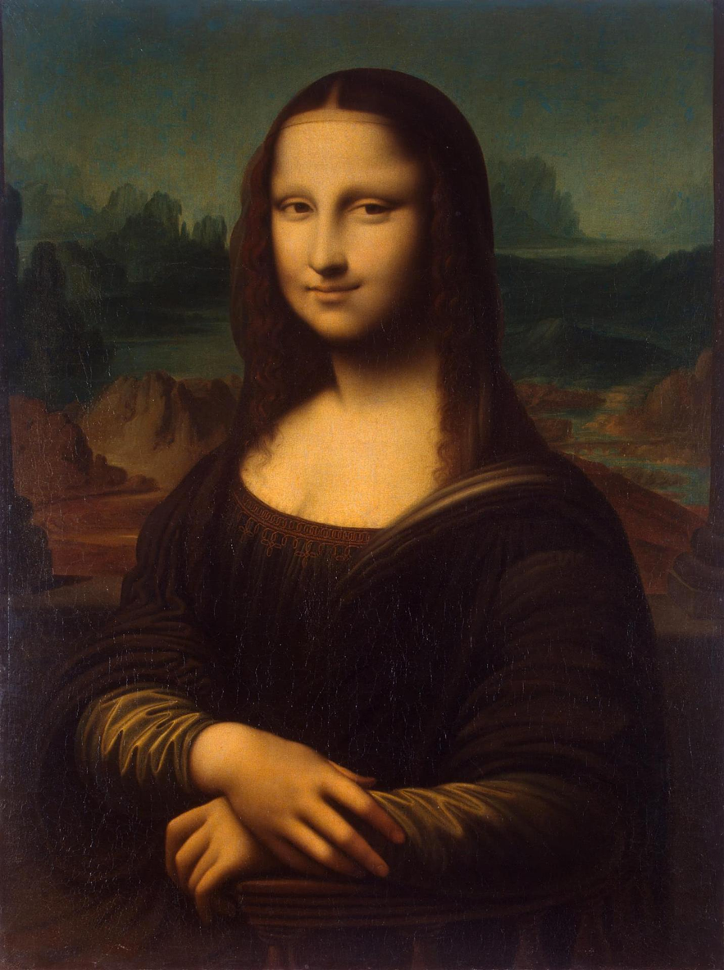
Pass by “Value”
- Thanks Mehran

Slide 156
More Examples

Slide 157
Changed Name
private void run() {
int num = 5;
cow(num);
}
private void cow(int grass) {
println(grass);
}

Slide 158
Same Variable Name
private void run() {
int num = 5;
cow();
println(num);
}
private void cow() {
int num = 10;
println(num);
}

Slide 159

No Methods in Methods
private void run() {
println(“hello world”);
private void sayGoodbye() {
println(“goodbye!”);
}
}
Illegal modifier for parameter goodbye, only final is permitted
Huh?!?

Slide 160
No Methods in Methods
private void run() {
println(“hello world”);
sayGoodbye();
}
private void sayGoodbye() {
println(“goodbye!”);
}

Slide 161
Methods Called on Objects
GRect rect = new GRect(20, 20);
rect.setColor(Color.Blue);
receiver
* We will talk about how to define these later in the class

Slide 162
Learn How To:
Write a method that takes in input
Write a method that gives back output
Trace method calls using stacks

Slide 163
Remember Booleans?

Slide 164
Boolean Variable
boolean karelIsAwesome = true;
boolean myBool = 1 < 2;

Slide 165
Boolean Operations
boolean a = true;
boolean b = false;
boolean and = a && b;
boolean or = a || b;
boolean not = !a;

Slide 166
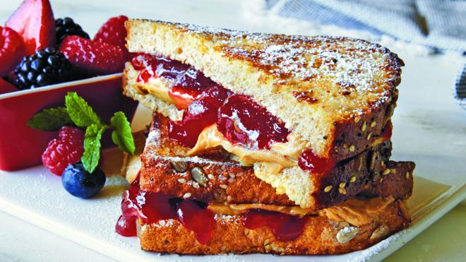

Slide 167
Is Square
private void run() {
for(int i = 1; i <= 100; i++) {
if(isSquare(i)) {
println(i);
}
}
}

Slide 168
Boolean Return
public void run() {
for(int i = 1; i <= 100; i++) {
if(isSquare(i)) {
println(i);
}
}
}
private boolean isSquare(int x) {
double root = Math.sqrt(x);
if(root == Math.floor(root)) {
return true;
} else {
return false;
}
}

Slide 169
Boolean Return
public void run() {
for(int i = 1; i <= 100; i++) {
if(isSquare(i)) {
println(i);
}
}
}
private boolean isSquare(int x) {
double root = Math.sqrt(x);
return root == Math.floor(root);
}

Slide 170
Boolean Return
public void run() {
for(int i = 1; i <= 100; i++) {
if(isSquare(i)) {
println(i);
}
}
}
private boolean isSquare(int x) {
double root = Math.sqrt(x);
return root == (int)root;
}

Slide 171

Extra Exercise
Greek mathematicians took a special interest in numbers that are equal to the sum of their proper divisors (a proper divisor of n is any divisor less than n itself). They called such numbers perfect numbers. For example, 6 is a perfect number because it is the sum of 1, 2, and 3, which are the integers less than 6 that divide evenly into 6. Similarly, 28 is a perfect number because it is the sum of 1, 2, 4, 7, and 14.
Design and implement a Java program that finds all the perfect numbers between two limits. For example, if the limits are 1 and 10000, the output should look like this:
FindPerfect
The perfect numbers between 1 and 10000 are:
6
28
496
8128

